Slide 1
Internship Performed at Borey Golden Park Company
From 1st Aug to 30th Nov, 2024

Slide 2
01
Overview of internship
02
Internship Project
03
Reflection
O
U
T
L I N
E
S
04
Personal Project
05
Conclusion

Slide 3







Overview of Internship
01
02
History of company
Company name
Mission
03
04
Core value
Organizational chart
Type of business
05
06

Slide 4
Organizational chart
Mr. Reaksmey
IT Manager
Mr. Bunthoeun
IT supervisor
Mr. Soching
Internship
Mrs. Sokunthea
Internship

Slide 5


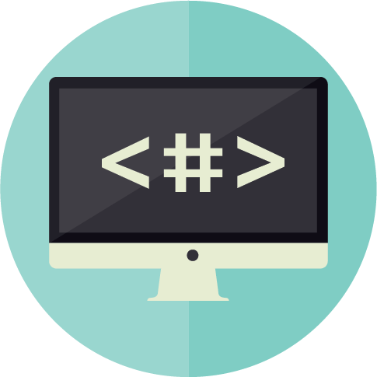



Internship Project
Training
Learning
Coding
To know how to use project and know process or flow
To learn about the new programming language.
Frontend and Backend
Testing
Database Analysis
Testing
To testing the process of project after training.
Find table name with attribute, relationship, and connecting
Testing and debugging code

Slide 6
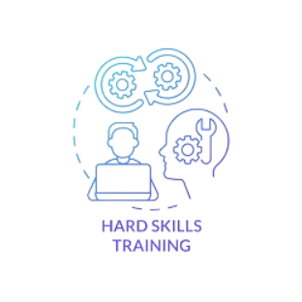



Reflection
Expectation of my internship
Good environment.
The process of working
Improving my technical skills and professional skills
Challenging
The new programming
language is C#
Technical skills from school apply at company
Programming skills
Database Management
Recommendation
Well Prepare
Communication

Slide 7

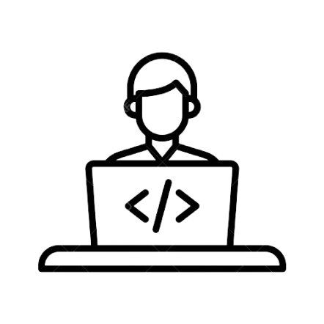


Personal Project
Continue to learn more about programming language course and project management
Improve problem solving
2025-2027
2028
2029
2030
2031-2035
Continue study on bachelor degree
Upgrade to Senior Web Developer
Improve my leadership skills and upgrade to Project Manager or team lead

Slide 8


Slide 9





Thank you !
www.passerellesnumeriques.org

